Slide 1

Introduction to PowerShell Module Development
@JONATHANMEDD
@PSSouthampton

Slide 2
DEMO Heavy
All the examples are in my GitHub repo, so no need to try and copy them down
https://github.com/jonathanmedd/Presentations/tree/master/PowerShell/Introduction%20to%20PowerShell%20Module%20Development

Slide 3
Mandatory context slide
What is the point of this? Why would I want to make a module, I just write a few scripts?
Maybe you need to:
Keep re-usable functions in an easy to access place
Collaborate and share code among your team
Make a PowerShell toolkit for a system which doesn’t have one – like PowervRA

Slide 4
Mandatory context slide 2
Makes sharing of groups of functions and scripts easy
Simple XCOPY style deployment of the module folder either internally or publishing to an external website
Make your commonly used functions available to yourself without ‘Profile Bloat’ – they are available as and when you need them from a module

Slide 5
How can you distribute additional PowerShell functionality?
Snapin – PowerShell v1
Provider or Cmdlets
Not for your average IT Pro to create
Typically involved developing in C#
Module – PowerShell v2 (Snapins still available up to 5.1)
Provider, Cmdlets, Functions, Variables and Aliases
Any IT Pro can make a module, it’s all done in PowerShell

Slide 6
What is a module?
Simple as a collection of files containing functions, scripts etc and possibly other files such as the manifest to make it more professional
Stored within a folder as a subfolder of the Modules location. Can be found via $env:PSModulePath
Contents made accessible to the user via the Import-Module cmdlet
(or since v3.0, via auto-loading)

Slide 7
Module Autoloading
Using a cmdlet in a command
Typing Get-ExecutionPolicy imports the Microsoft.PowerShell.Security module
Using the Get-Command cmdlet to get the command
Typing Get-Command Get-JobTrigger imports the PSScheduledJob module
Using the Get-Help cmdlet to get help for a cmdlet
Typing Get-Help Get-WinEvent imports the Microsoft.PowerShell.Diagnostics module

Slide 8
Making Your First Module
Create two functions
Save them into a *.psm1 file to the module folder
Import them for use into your session
Go!

Slide 9
Demo – Create a Module

Slide 10
Making Your Module More Professional
Create a Module Manifest using New-ModuleManifest
Include Authoring or Version info
Specify minimum versions of PowerShell or .NET required for the module
Nest other modules
Run scripts prior to loading the module, e.g. check for third-party snapin dependencies
Can be created manually
Use Test-ModuleManifest to check for issues

Slide 11
Demo – Create The Manifest

Slide 12
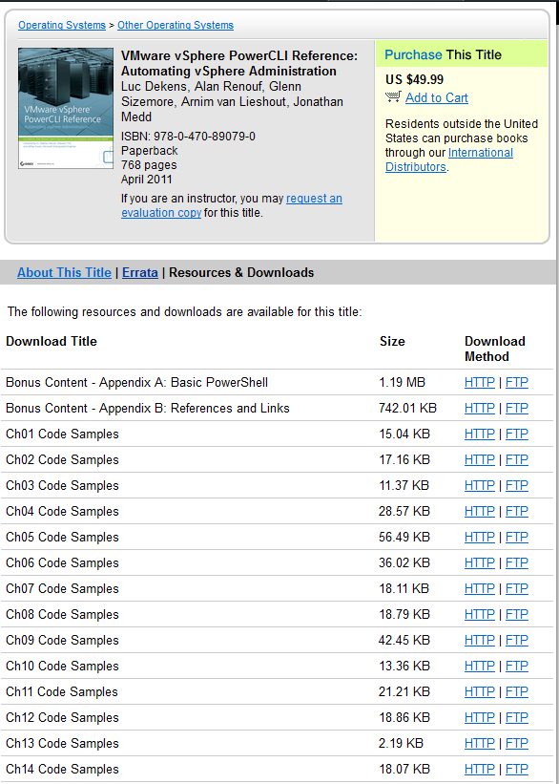
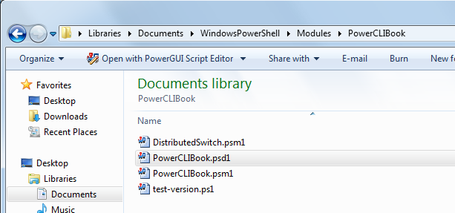
Modules Make Distributing Your Code Easier
VS

Slide 13
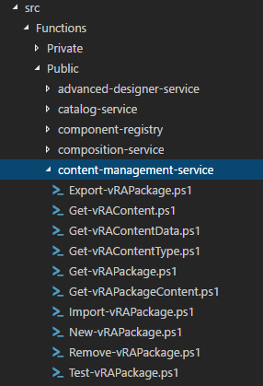
Collaborative development
Public and Private functions folders in GitHub repo
Each function in a separate file
Makes it easier to work on individual functions
Less likely to get Merge Conflicts
Have a build process to condense them down to a module artifact
Avoid performance issues with cert checks when importing the Module

Slide 14
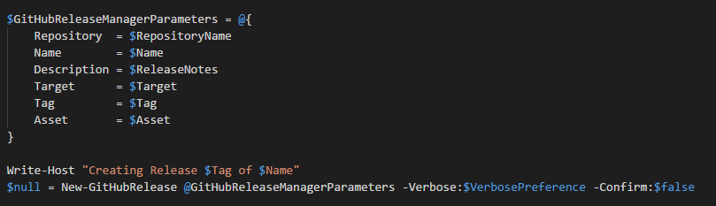
Publish to Github
Publish the Module as a Release in GitHub
Use the GitHubReleaseManager module

Slide 15
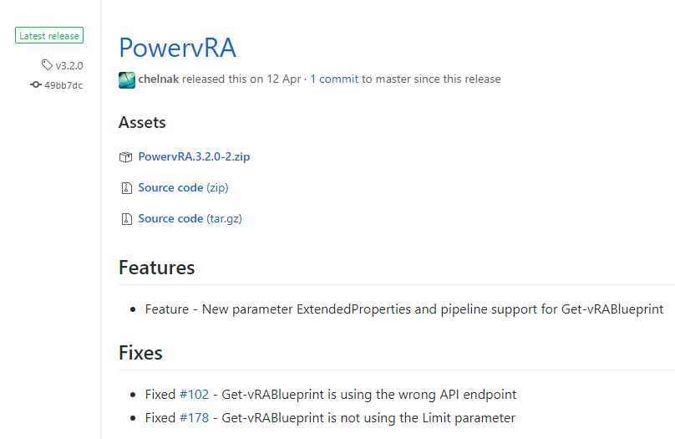
Publish to Github

Slide 16
Publish to the PowerShell Gallery
Publish the module to the PowerShell Gallery
Publish-Module -Name ModuleName -NuGetApiKey xxxxxxxx
Uses items from the Manifest to populate the gallery
Then can be consumed via Install-Module ModuleName

Slide 17
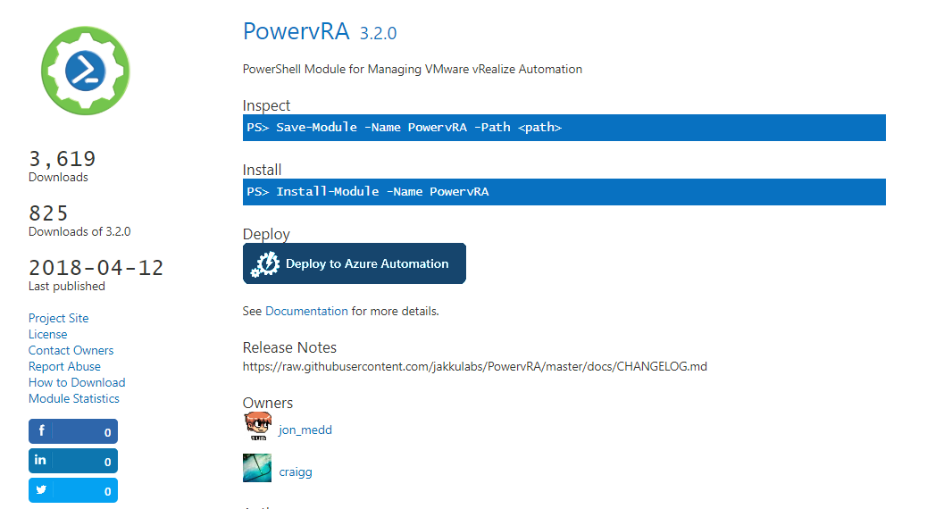
Publish to the PowerShell Gallery

Slide 18
Demo – PowerVRA Module
Show the tools folder……

Slide 19
Plaster
Plaster is a template-based file and project generator written in PowerShell.
Its purpose is to streamline the creation of PowerShell module projects, Pester tests, DSC configurations, and more.
File generation is performed using crafted templates which allow the user to fill in details and choose from options to get their desired output.

Slide 20
resources
Get-Help about_Modules
http://www.simple-talk.com/sysadmin/powershell/an-introduction-to-powershell-modules/
https://blogs.technet.microsoft.com/heyscriptingguy/2010/01/18/hey-scripting-guy-tell-me-about-modules-in-windows-powershell-2-0/

Slide 21
SUMMARY
Create re-usable code in functions and store them in modules for easy distribution and sharing
Create a separate process and structure for module development, then a build process to create the module artifact and publish to GitHub / PowerShell Gallery

